Slide 1
Ch. 1
Objective 1: To determine the impact of invasive S. horneri wrack on the feeding and performance of
dominant consumers of rocky shore communities
Q1. Do grazers show a feeding preference between native M. pyrifera and invasive S. horneri?
Q2. How does a diet including S. horneri affect the performance of grazers?
Q3. How does palatability of seaweed wrack change with degradation?
Ch. 2
Objective 2: To determine the impact of S. horneri wrack on the grazing pressure experienced by native benthic seaweeds in recipient rocky shore communities
Q4. Does the presence of S. horneri in the wrack shift grazing onto native benthic seaweeds?
Q5. Does grazing pressure on native benthic seaweeds change with wrack degradation?
Objective 3: To determine if wrack use and duration on the rocky shore differ between M. pyrifera
and S. horneri Q6. Does degradation impact wrack retention in the field? Q7. Does wrack use as habitat decrease with degradation?
Ch. 3
Objective 4: To assess if Sargassum spp. disposal impacts recipient terrestrial communities
Q8. Do Sargassum deposits provide a nutrient subsidy to terrestrial communities?
Q9. Do Sargassum deposits influence community dynamics?
Notes:
I will attempt to bridge this gap with four objectives

Slide 2
Do grazers show a preference between kelp and sargassum in the lab?
Lab Assays

Slide 3
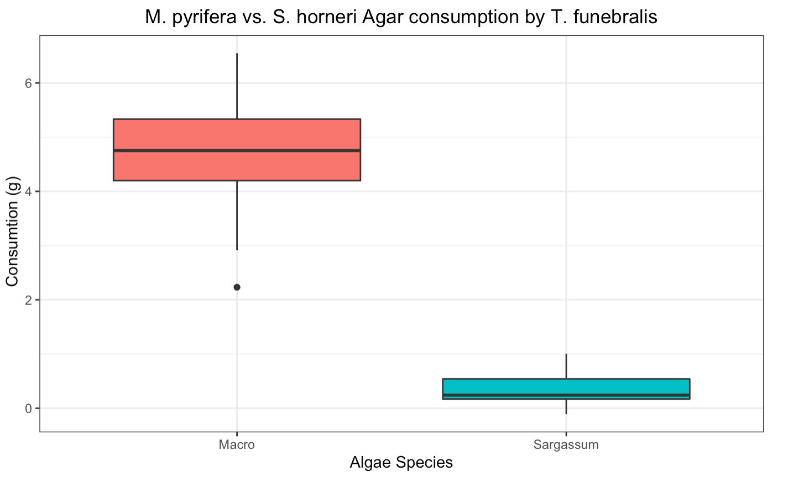
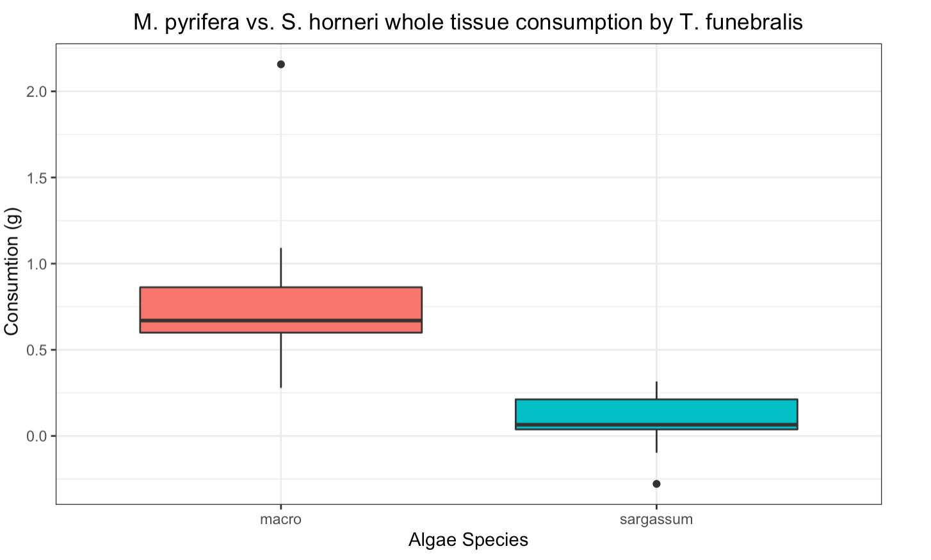
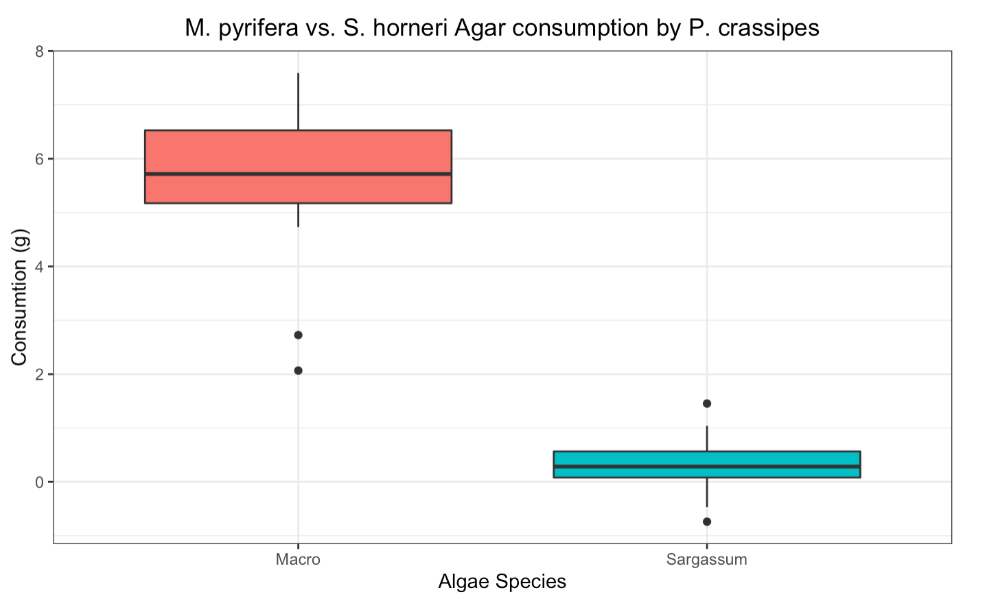
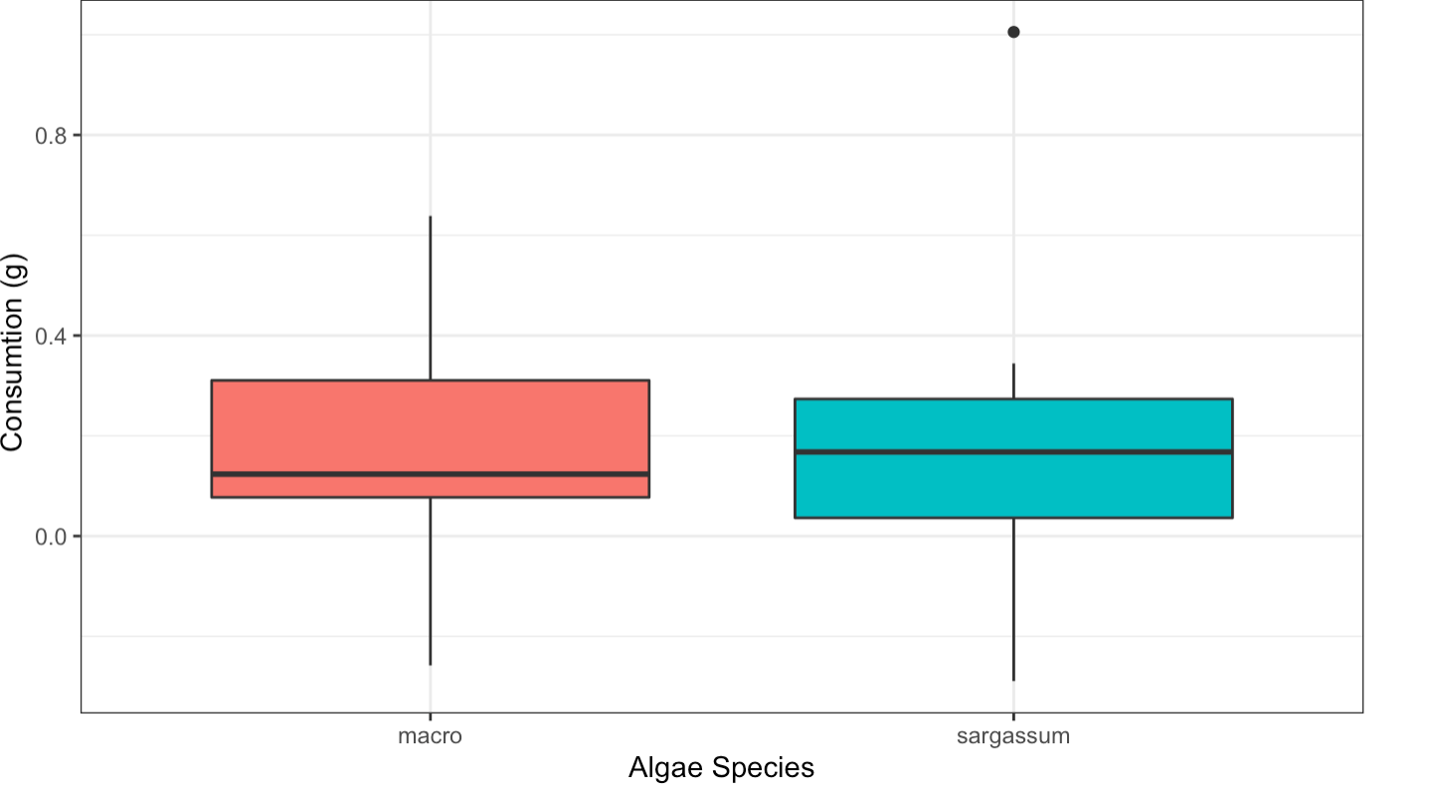
t = 12.117, df = 13, p-value = 1.859e-08
t = -5.7152, df = 13, p-value = 7.111e-05
t = 10.343, df = 11, p-value = 5.27e-07
t = -0.073928, df = 13, p-value = 0.9422

Slide 4
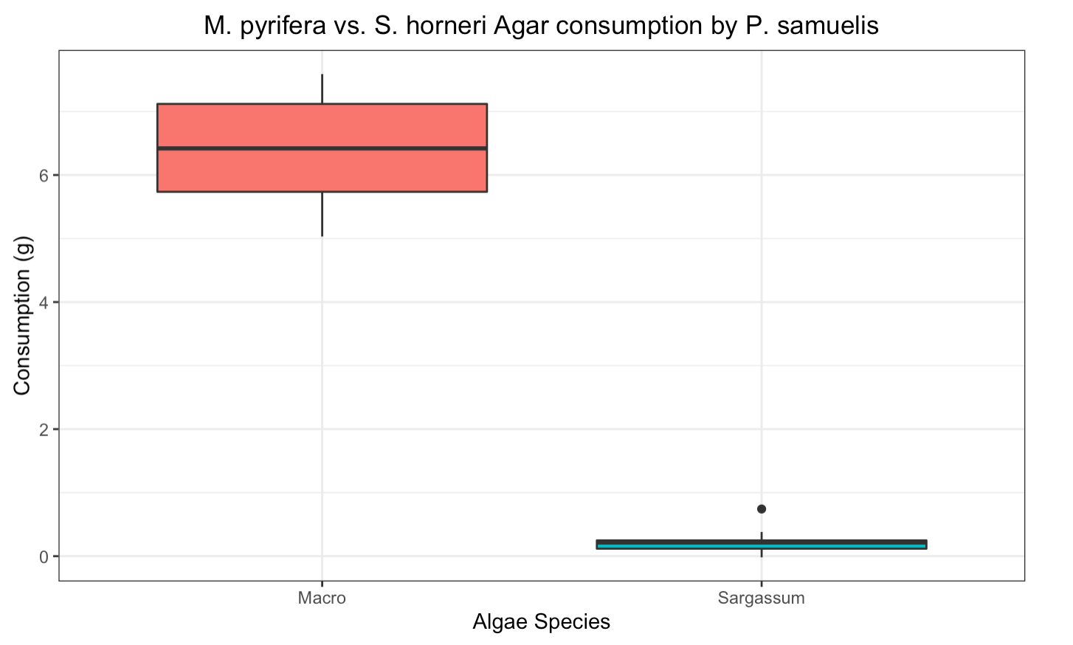
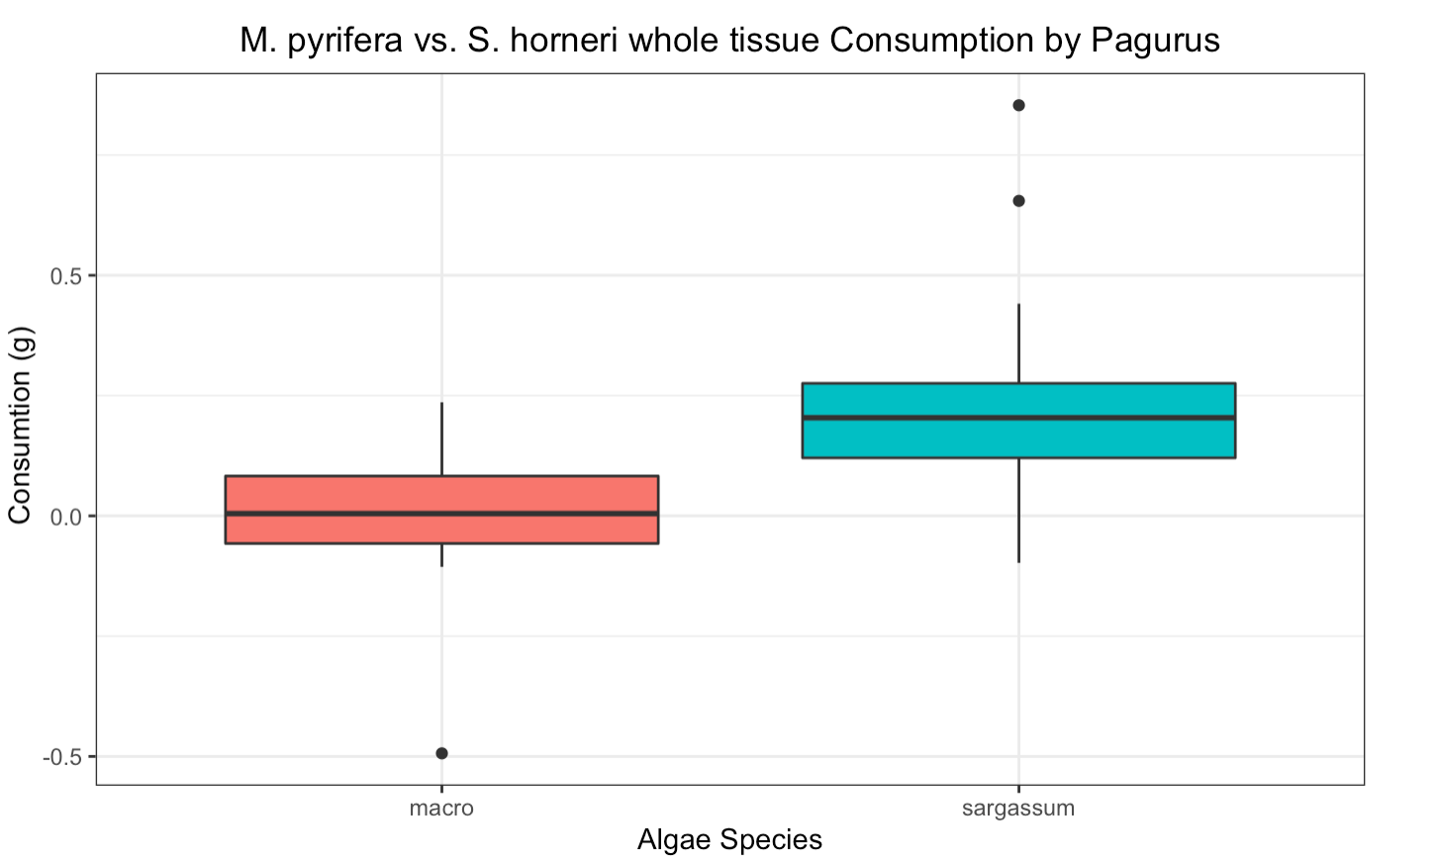
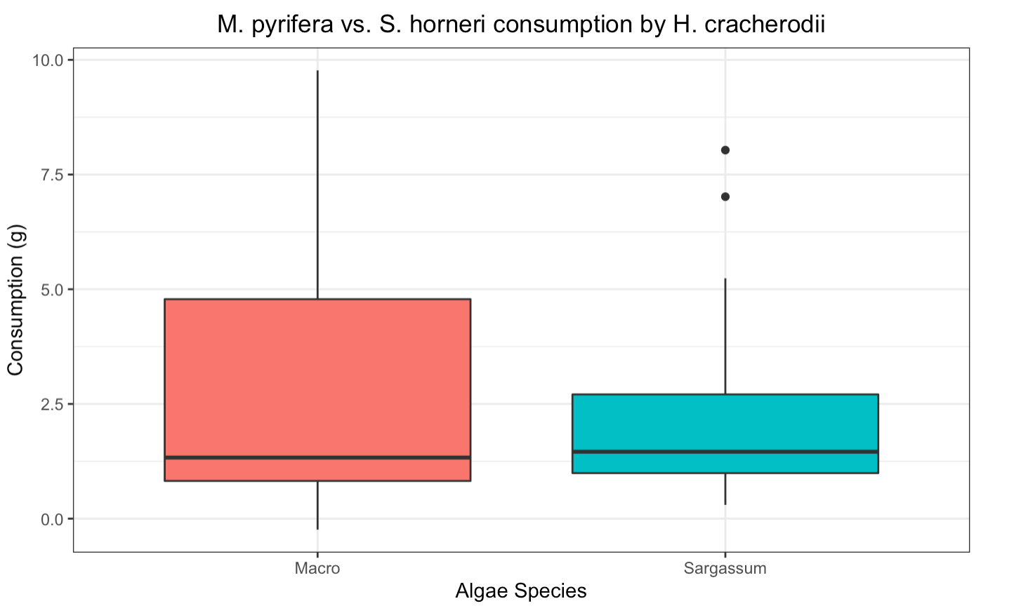
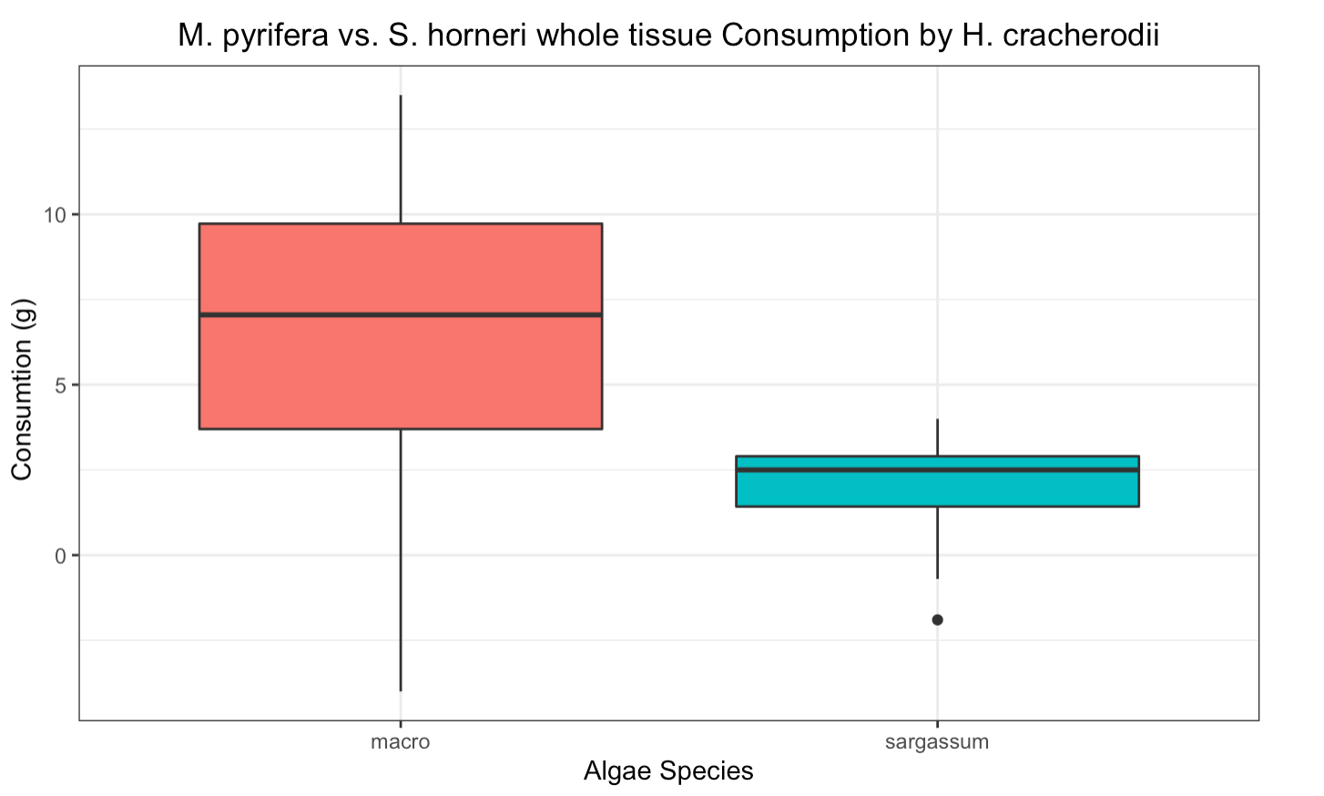
t = 26.132, df = 13, p-value = 1.272e-12
t = 3.7593, df = 13, p-value = 0.002385
t = 0.49654, df = 14, p-value = 0.6272
t = 4.5053, df = 15, p-value = 0.0004189

Slide 5
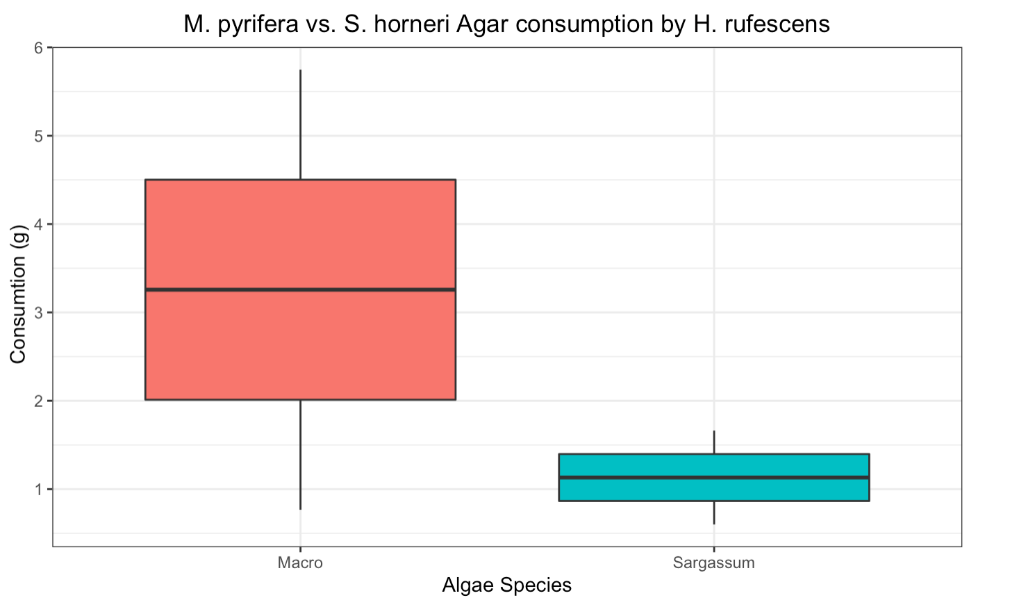
t = 1.0852, df = 1, p-value = 0.474

Slide 6
Does consumption differ between whole tissue and agar-based kelp food?

Slide 7
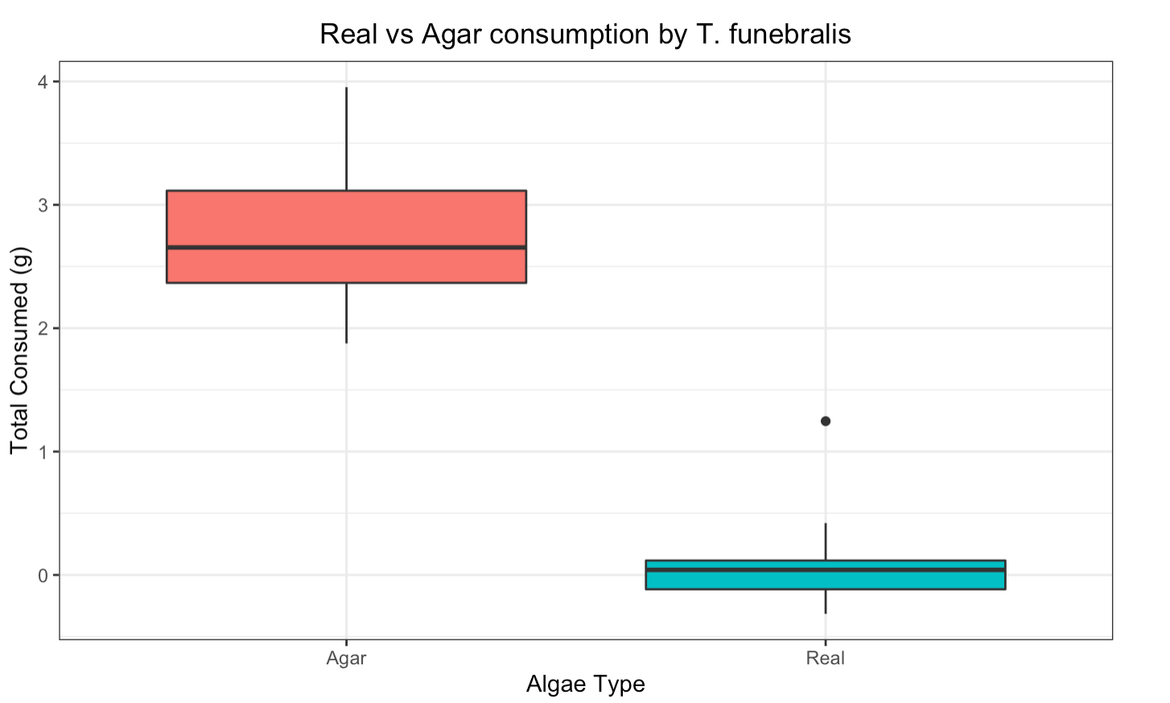

t = 15.928, df = 13, p-value = 6.57e-10
t = 10.121, df = 13, p-value = 1.565e-07

Slide 8
Does palatability change with ontogeny?
Agar Assays

Slide 9
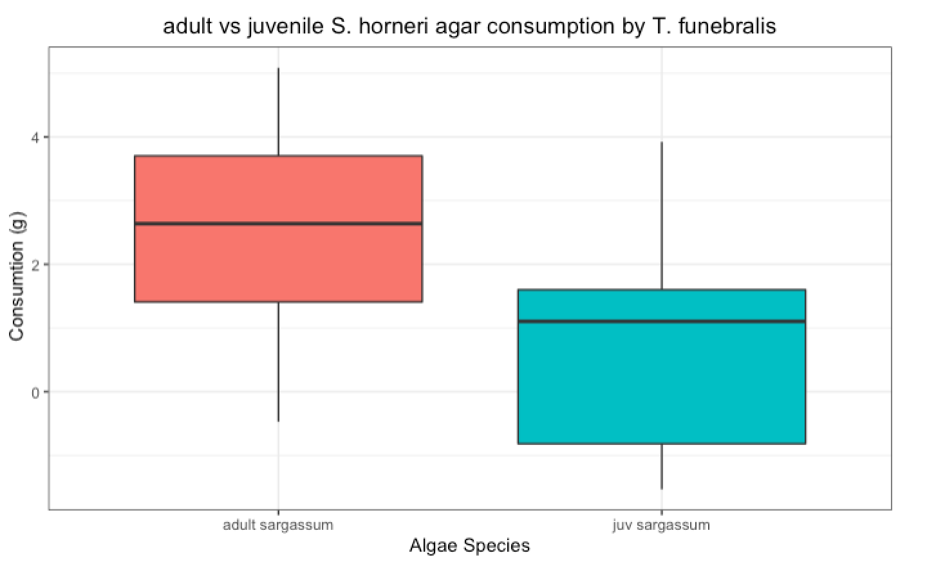
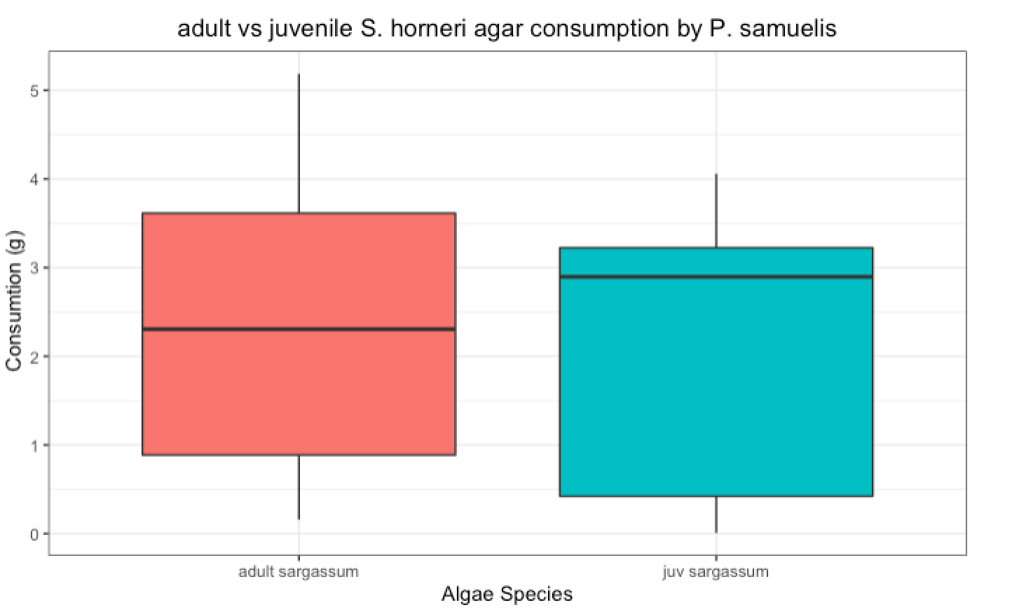
t = 1.8616, df = 13, p-value = 0.08542
t = 0.12753, df = 13, p-value = 0.9005

Slide 10
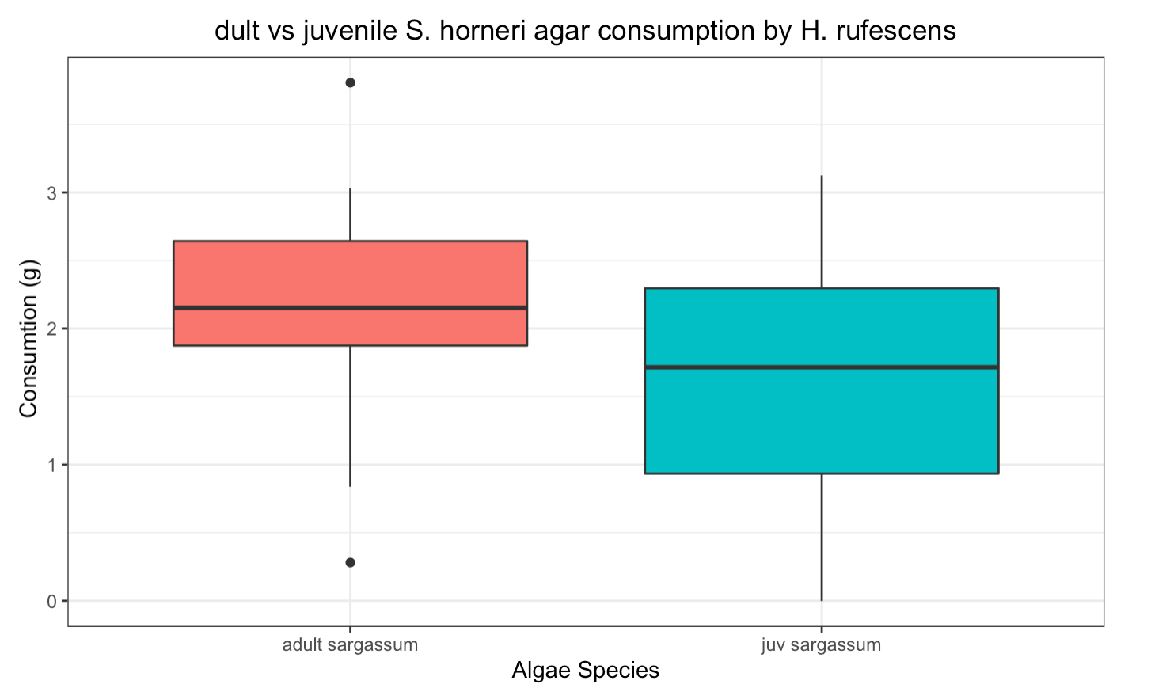
t = 1.3347, df = 13, p-value = 0.2049

Slide 11
How does a diet with Sargassum impact growth?
Tegula and Red Abalone
Growth as a percent of initial weight
(final weight-initial weight) x 100
initial

Slide 12
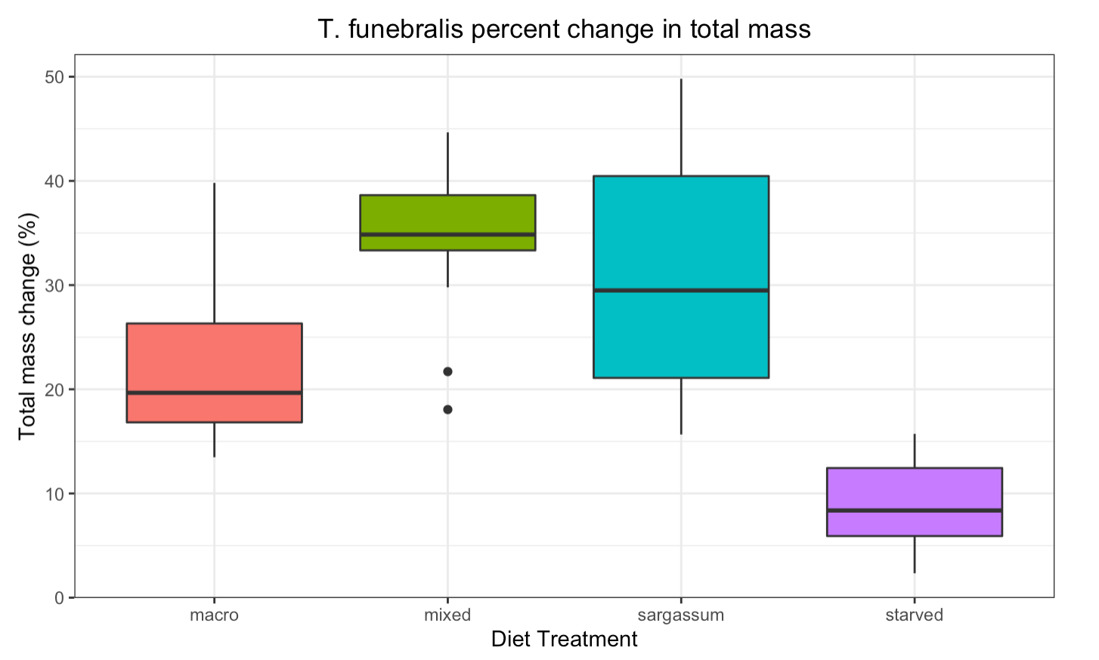

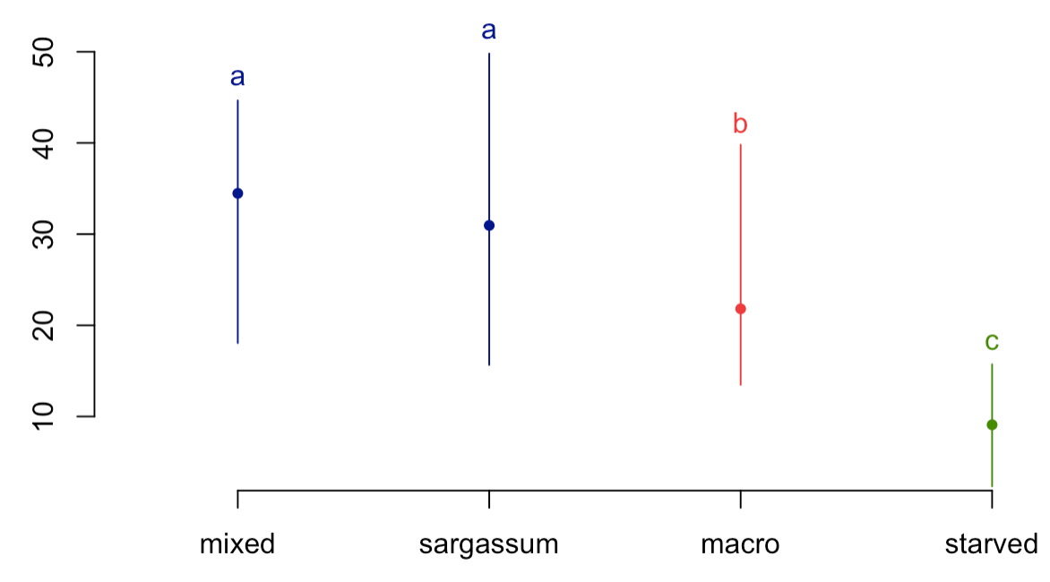

Slide 13
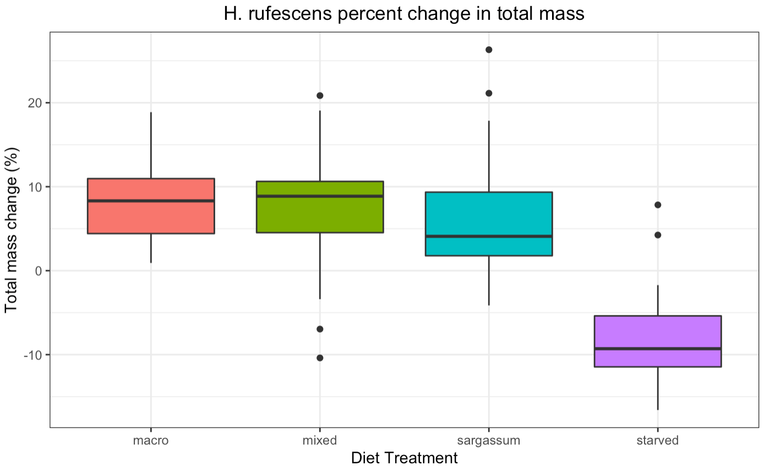

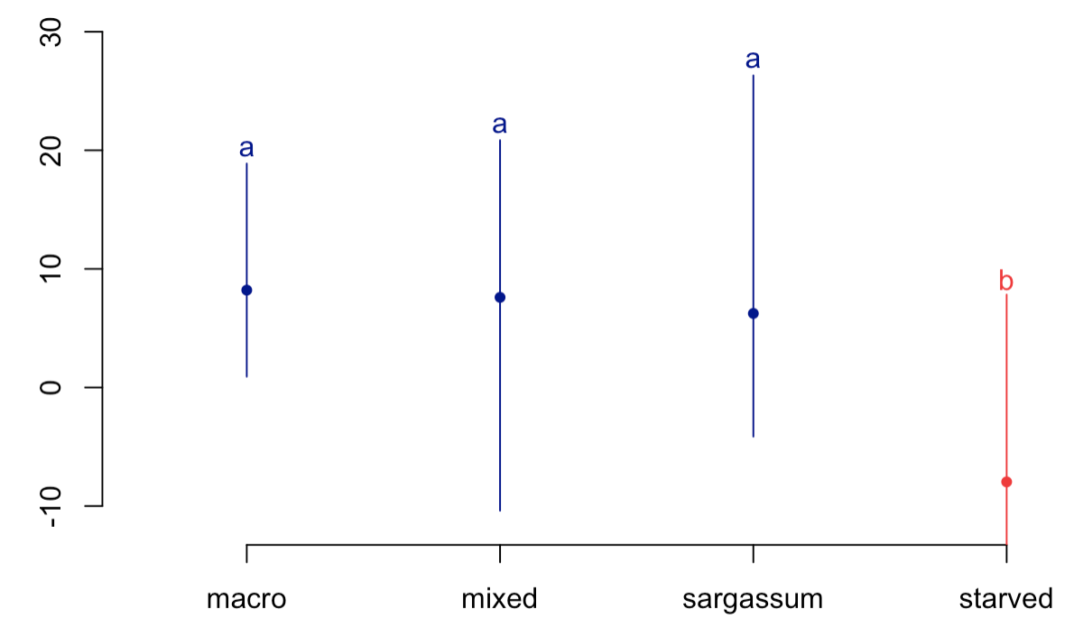

Slide 14
How does palatability of seaweed wrack change with degradation?
Experimental assay setup: food choice assay between S. horneri and M. pyrifera
aged for 1 week and then aged for 2 weeks.
Intended analysis: regression using total consumption per species over time aged
Issue: seaweeds became completely degraded before week 3.

Slide 15
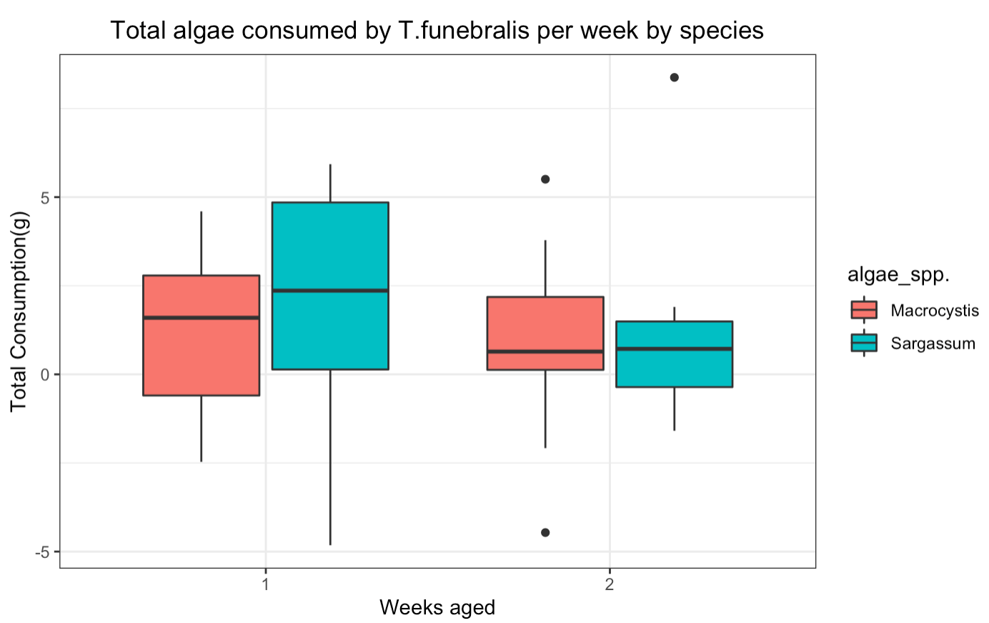
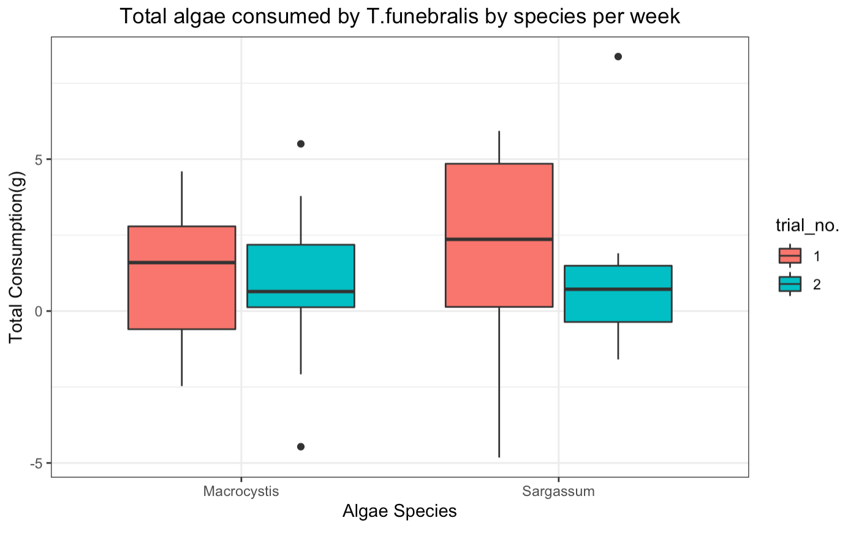
No analysis yet

Slide 16
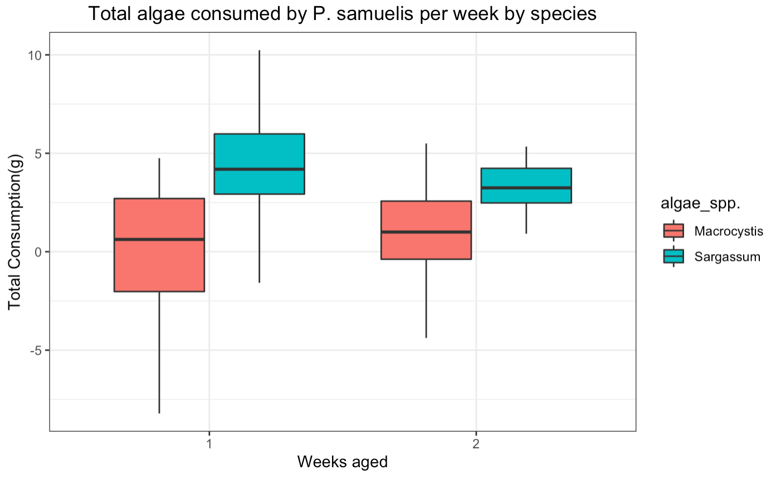
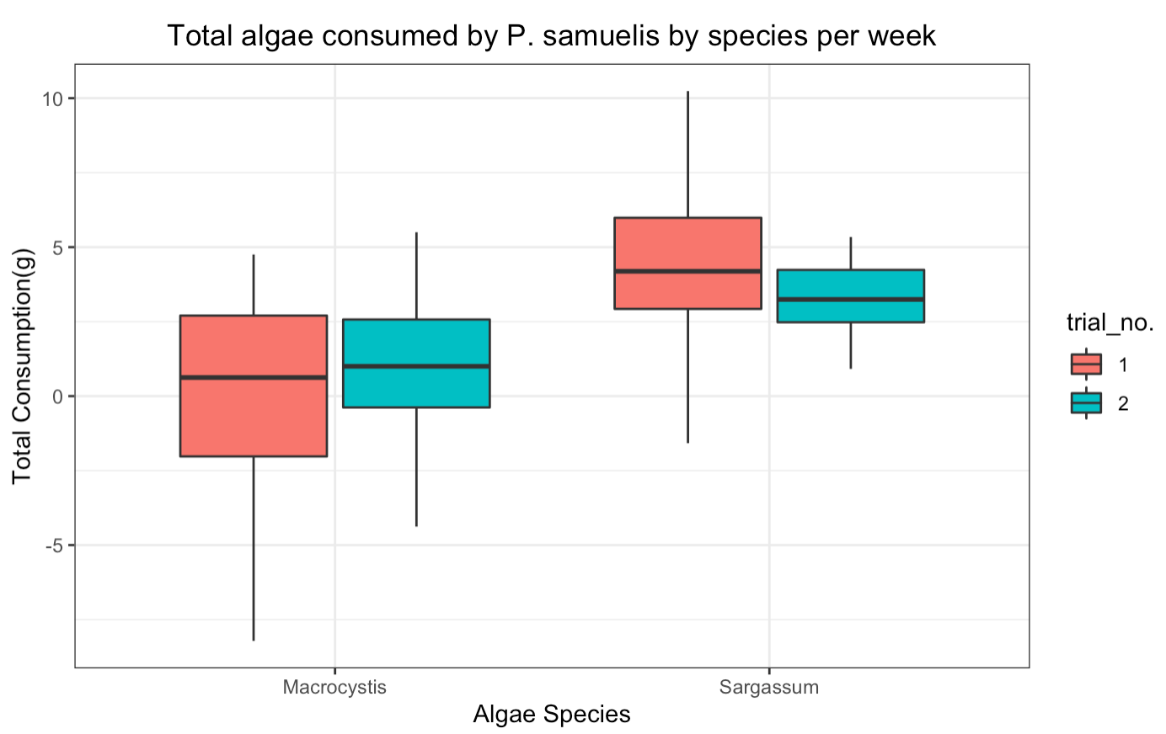
No analysis yet

Slide 17
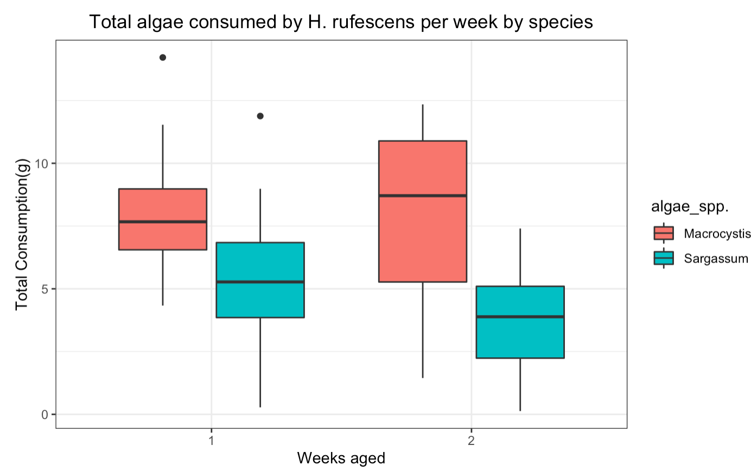
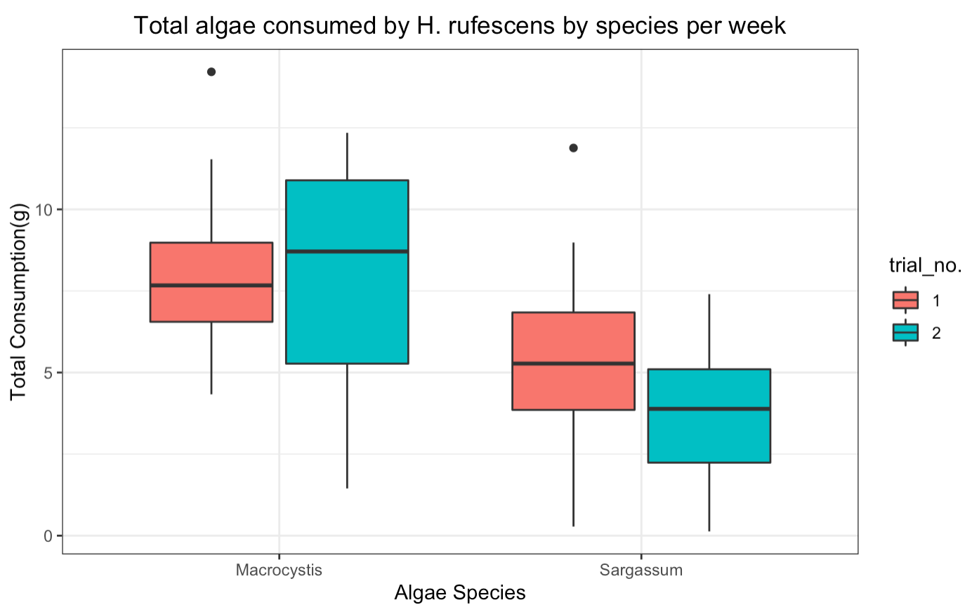
No analysis yet

Slide 18
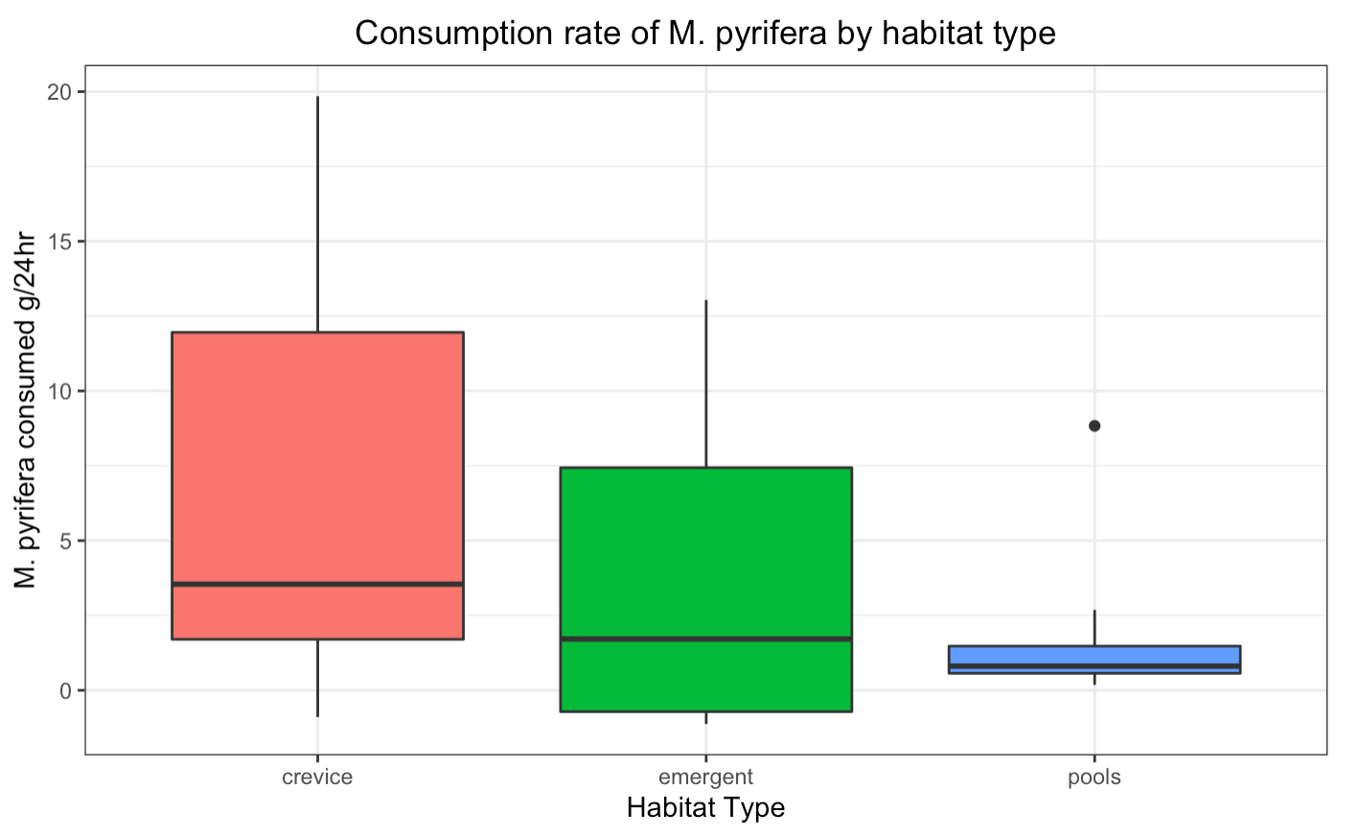
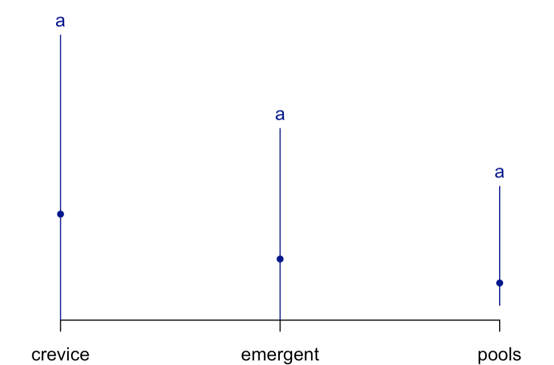

Does consumption differ between habitats in the field?
San Nic, Cosign
Association
Crevice- Abalone and tegula
Emergent- striped shore crabs and tegula
Pools- hermit crabs
Experiment- deployed kelp agar foods in 3 habitat types

Slide 19
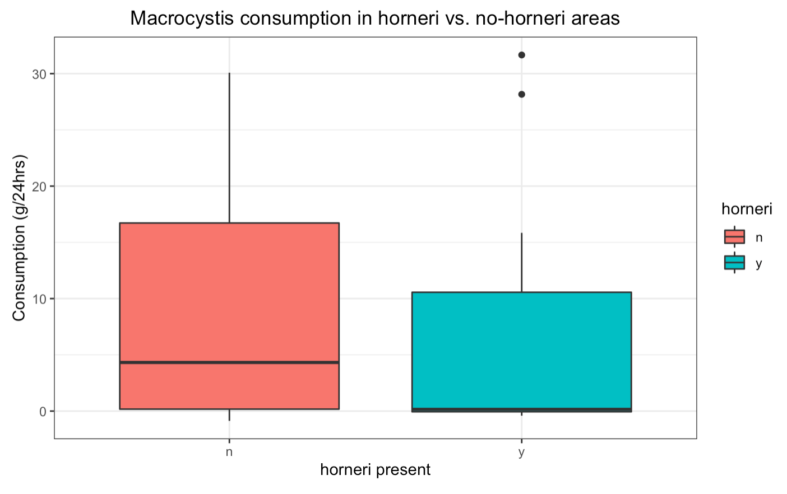
Does consumption differ between pools in the presence or absence of S. horneri ?
Experiment- deployed petri dishes in pools with S. horneri
y= deployed on side with S. horneri near
n= deployed on side without S. horneri near
San Clemente, SHOBA
T test
t = 0.64124, df = 28.914, p-value = 0.5264
N=15
Issue: design is paired, so the above T test is inadequate. To run a paired T test should I
Remove pools that were n,n, and pools that were y,y?
(no sargassum in the pool, pool was 100% sargassum)
If so: t = 0.7671, df = 11, p-value = 0.4592 n=12

Slide 20
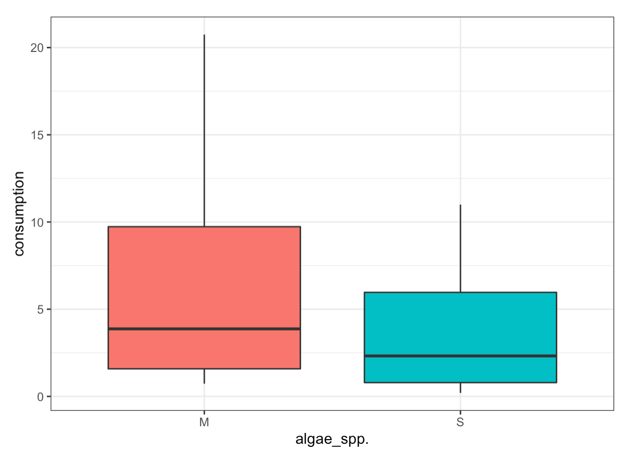
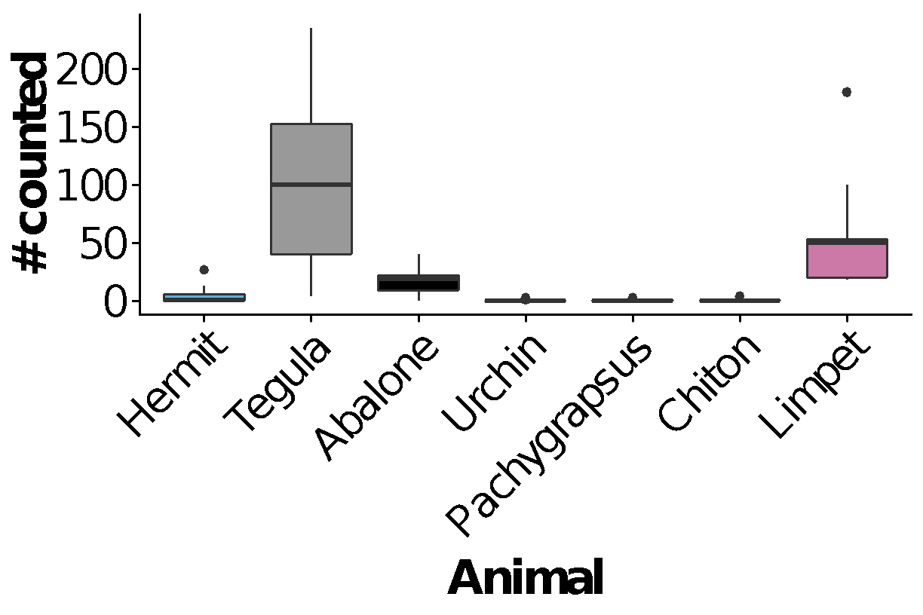
Do grazers consume more M. pyrifera or S. horneri in ”abalone habitat?”
Experiment: Deployed agar-based M. pyrifera and S. horneri foods in habitats where abalone were found but did not exclude any species
LMEM: 𝛘² = 3.804, df = 1, p = 0.0511
*block as a random effect
Animal densities within a 0.5m radius of experiments

Slide 21
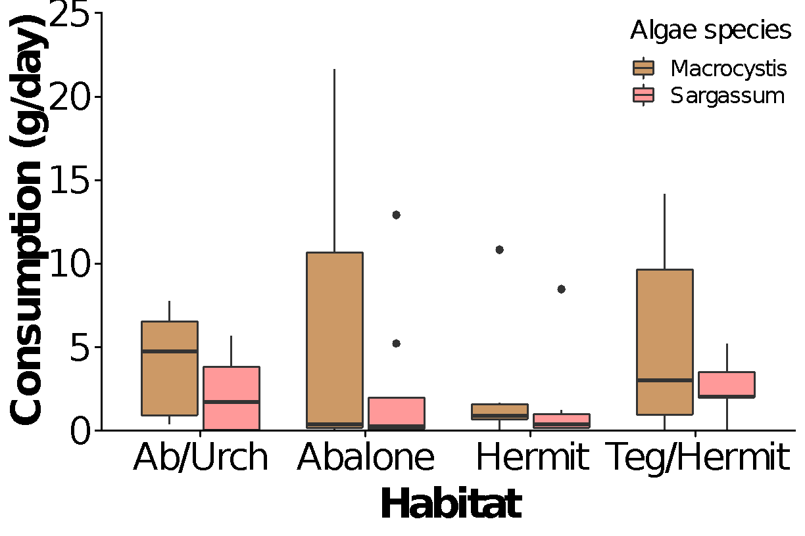
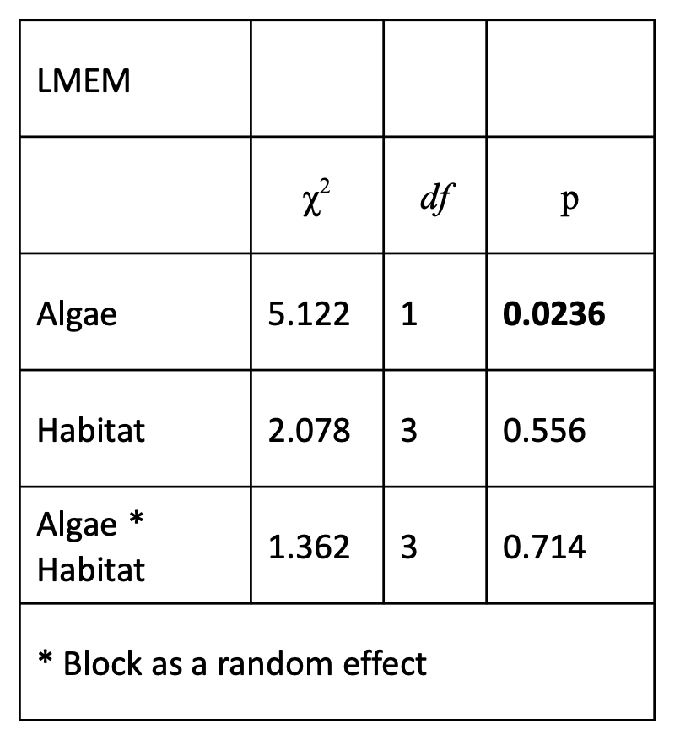
Does grazer preference change with habitat?
Experiment: Deployed agar-based M. pyrifera and S. horneri in various habitat types:
AB/Urch: overhang on the north-most side of the site
Abalone: crevices and crevices with pools
Hermit: pools dominated by hermits
Teg/herm, long horizontal pool consisting of both tegula and hermits

Slide 22
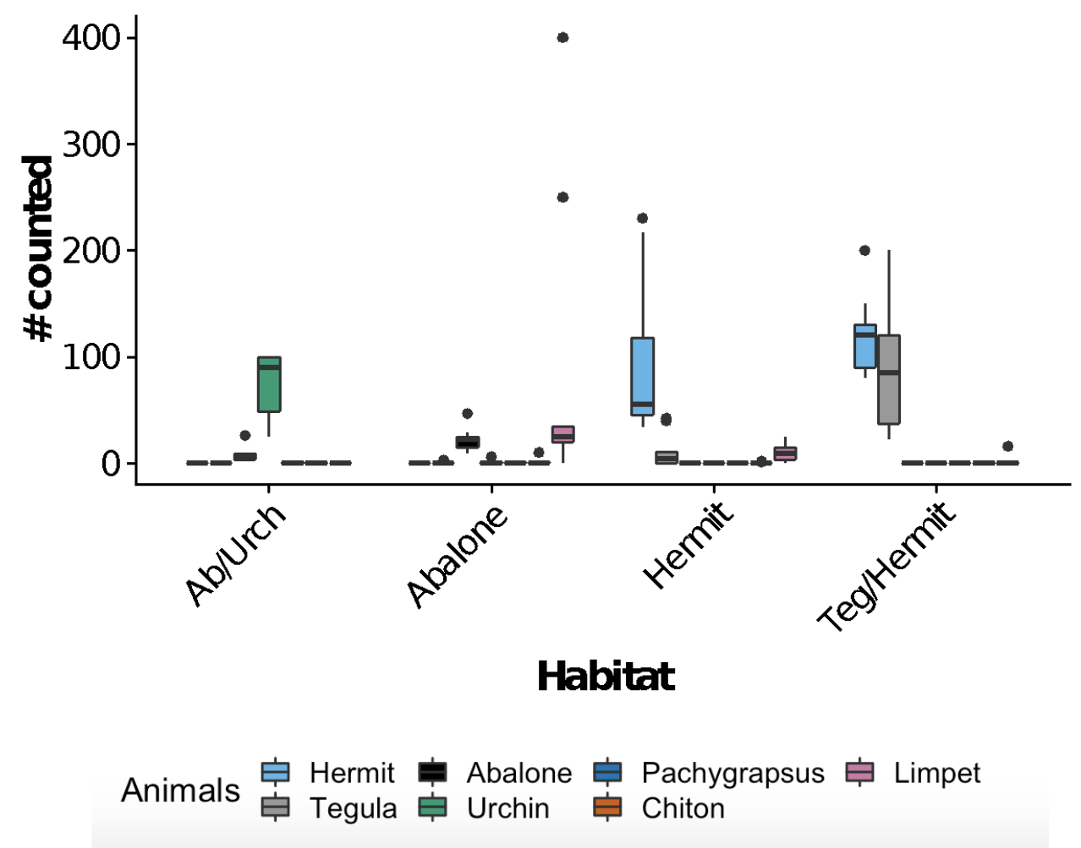
Does grazer preference change with habitat?
Experiment: Deployed agar-based M. pyrifera and S. horneri in various habitat types:
AB/Urch: overhang on the north-most side of the site
Abalone: crevices and crevices with pools
Hermit: pools dominated by hermits
Teg/herm, long horizontal pool consisting of both tegula and hermits

Slide 23
We conducted several Surveys to help us understand the ecological role of drift Kelp as a subsidy to coastal grazers

Slide 24
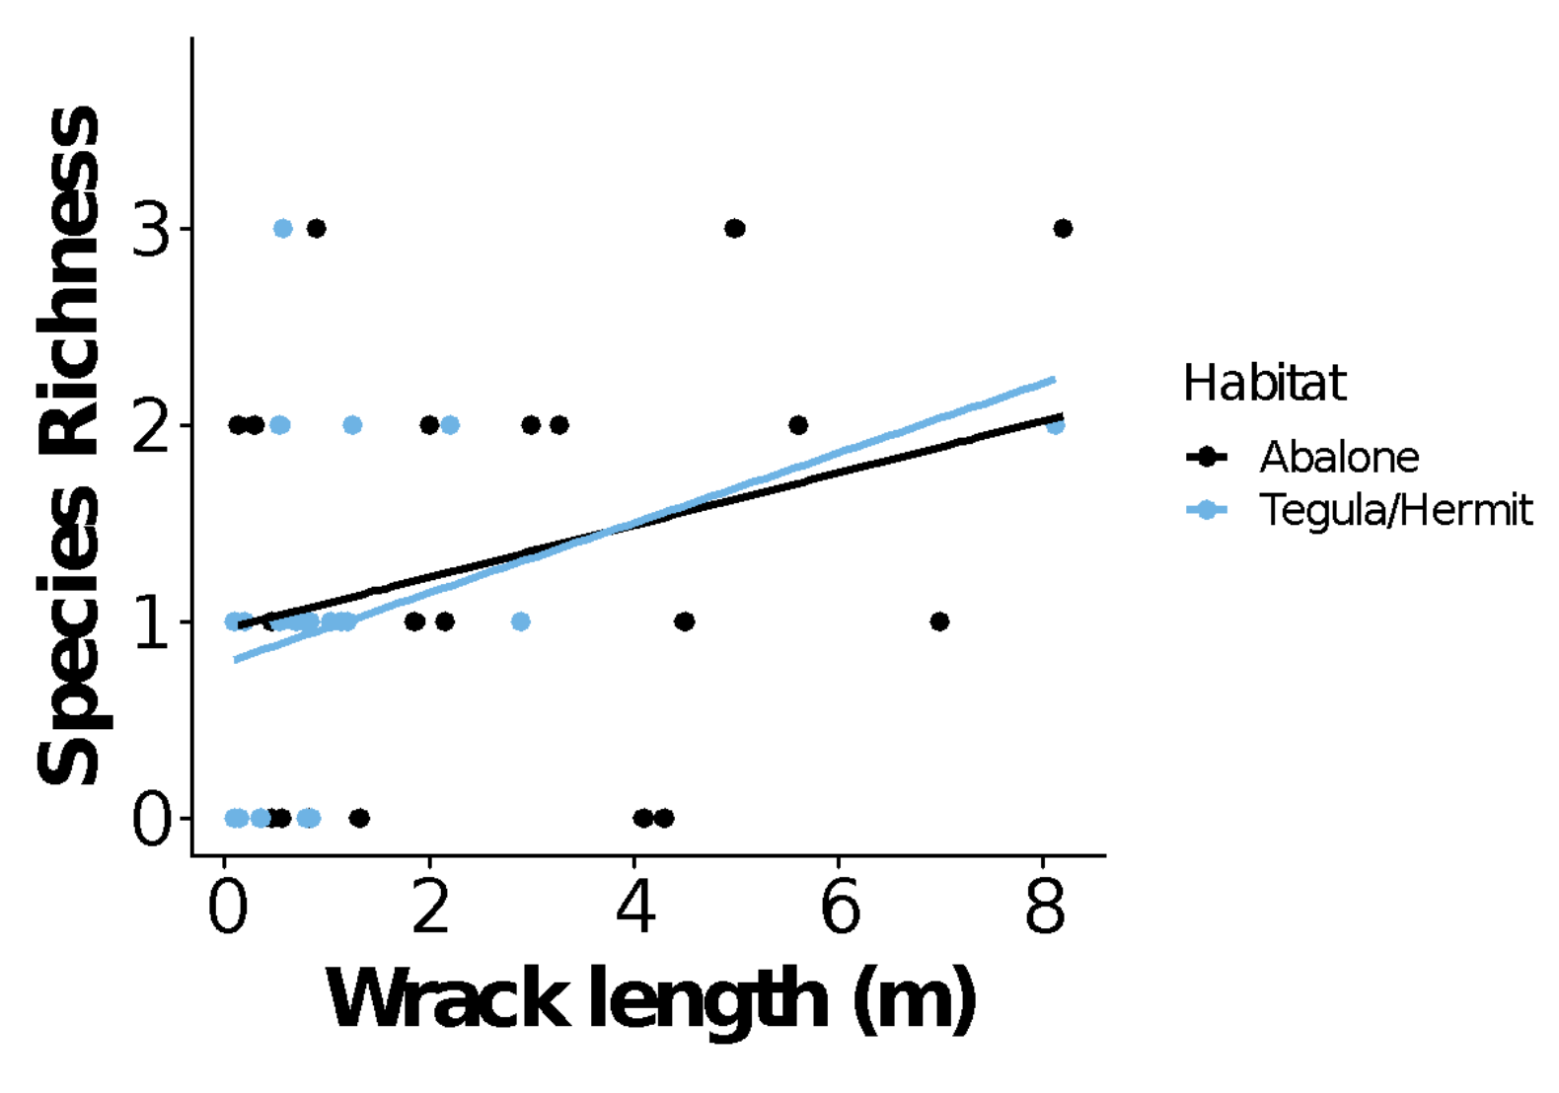
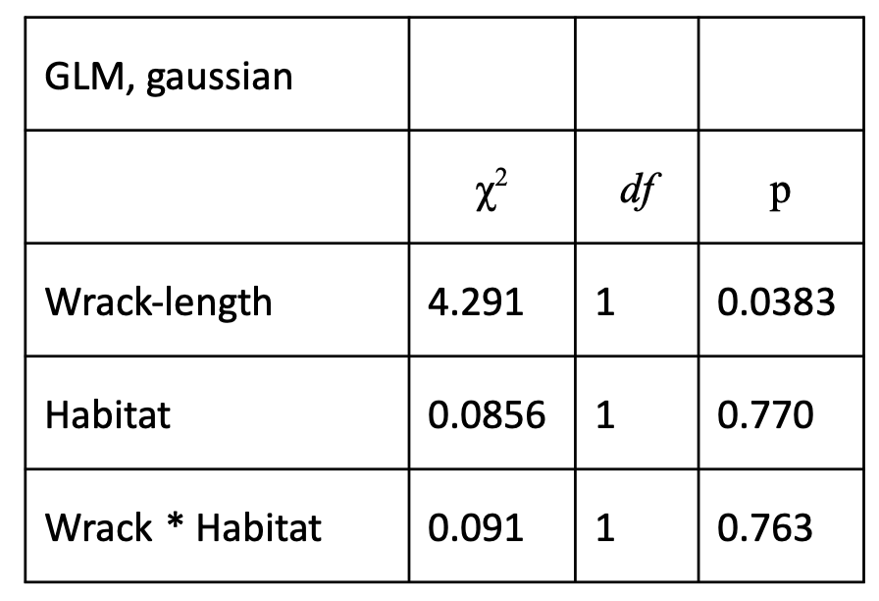
Does species richness increase with kelp length?

Slide 25
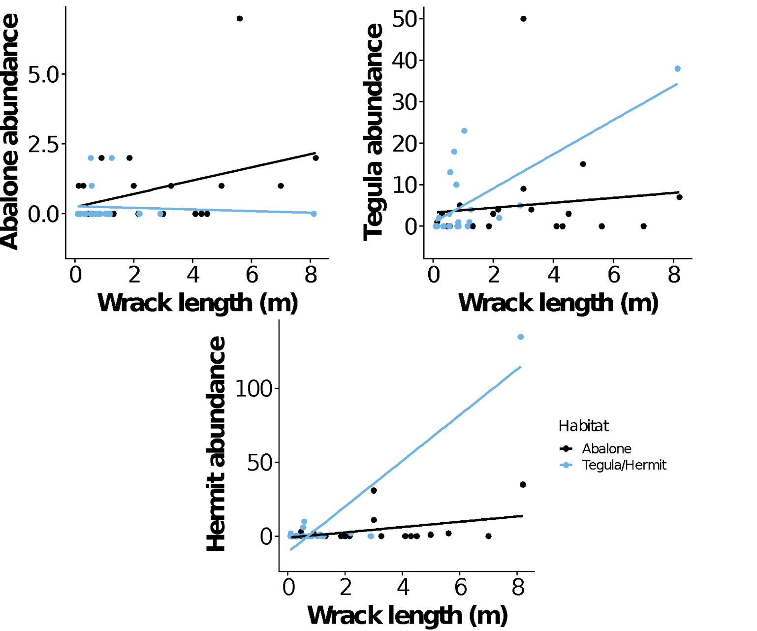
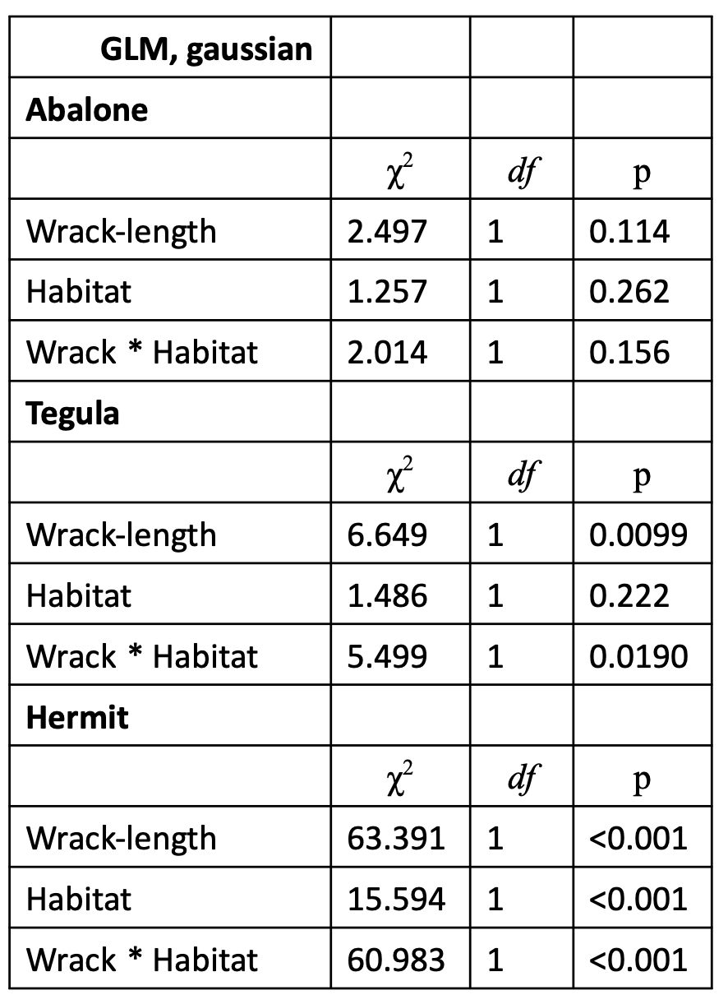
Do kelp length and habitat type explain species abundance?

Slide 26
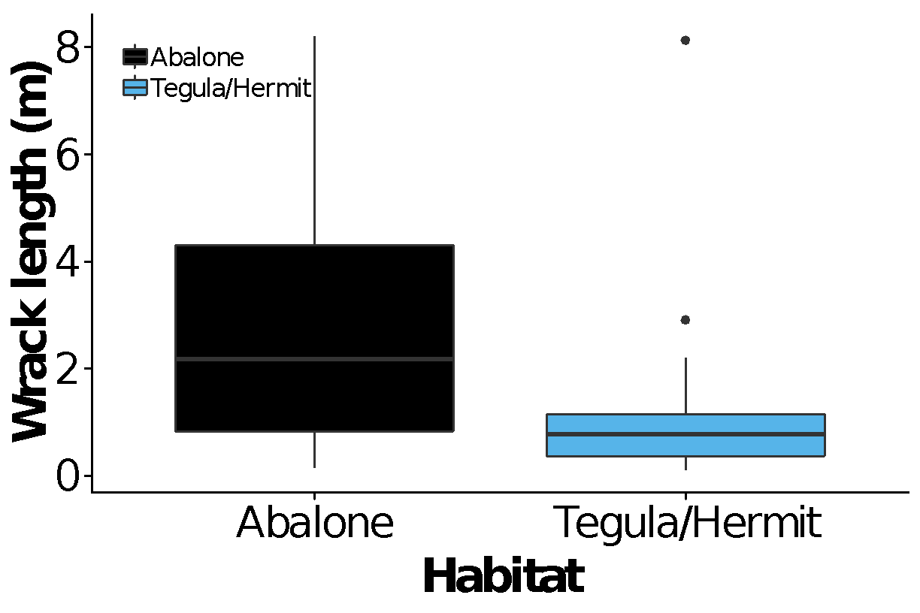
Does wrack length differ by habitat type?

Slide 27
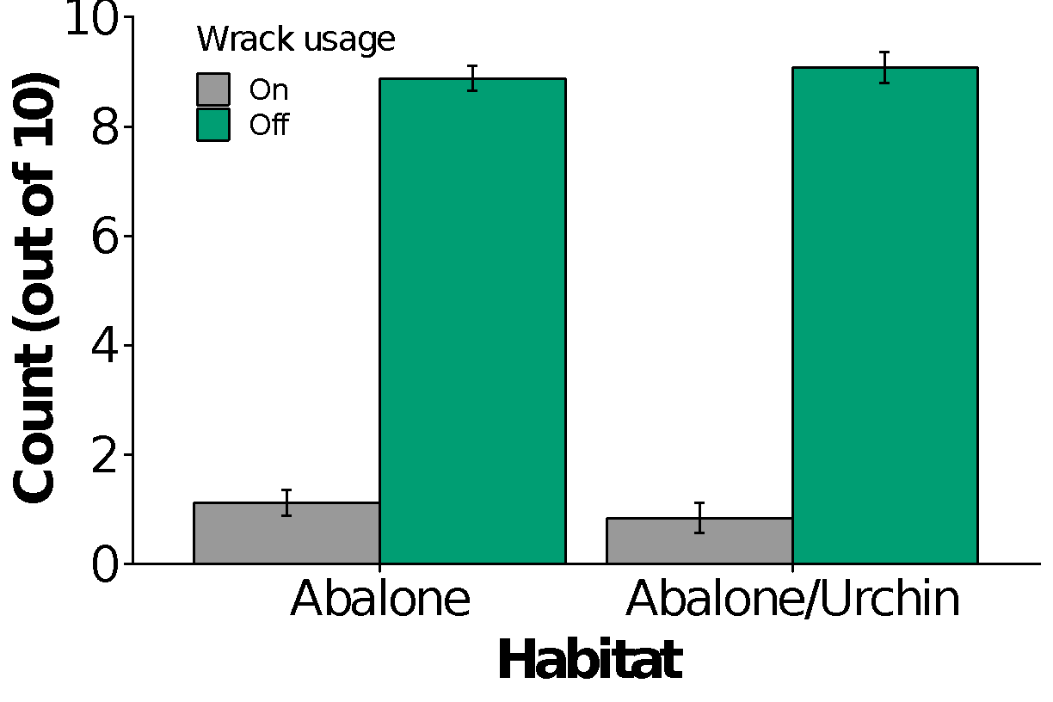
Do abalone utilize wrack
2 transects, parallel to waves
2 habitats surveyed
1 transect – Abalone Habitat (low/mid)
1 transect – Abalone/Urchin Habitat (low)
27 survey points in each habitat
Every 2m, the 10 closest abalone were assessed to determine if they were on/off wrack

Slide 28
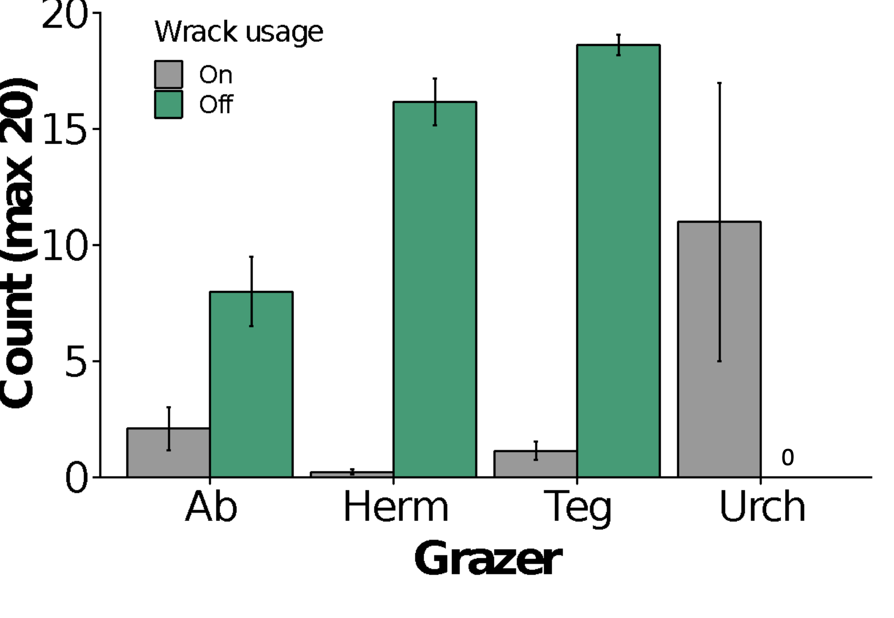
Do grazer utilize wrack?
3 transects, perpendicular to waves
Counted up to 20 grazers, either on/off wrack every 2m
Total points sampled = 46 points
Abalone, present at 11 points
Tegula, present at 43 points
Hermit, present at 39 points
Urchin, present at 2 points
**So animals varied across sampling space***

Slide 29
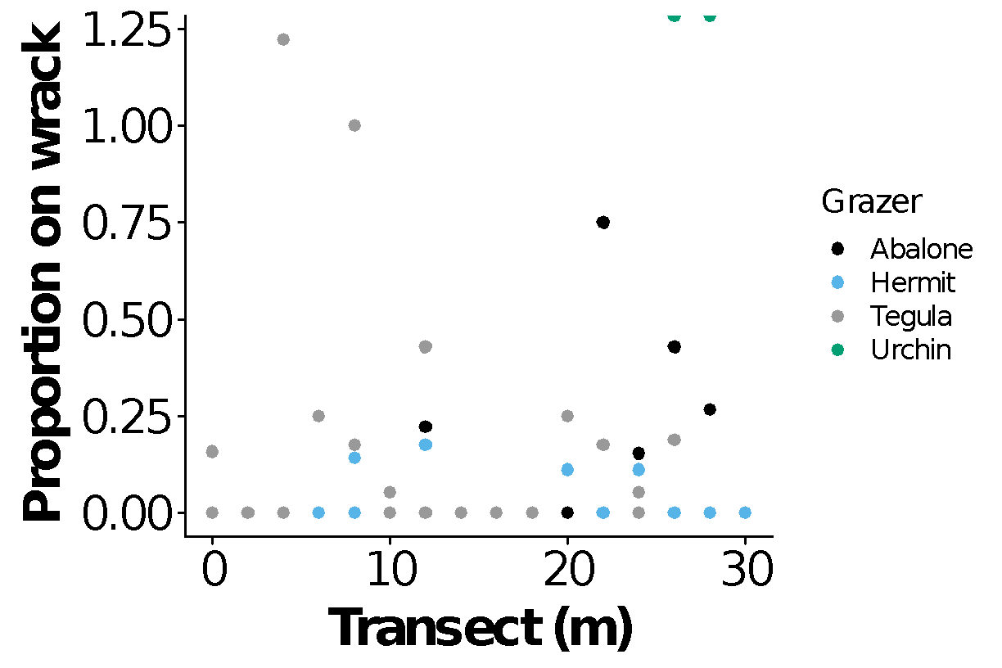
Does the proportion of grazers ON wrack change with distance from water?
*Its hard to ask this for tegula and hermit crab bc we stopped at 20
*But we would probably say yes – for urchin and abalone, but too few data points

Slide 30
invasive wrack surveys
-Invasive wrack surveys2 sites – Cosign (n = 19) and W Marker Poles (n = 20) Kelp patties measured if about 1m or greater -Each patty measured for l x w then scaled to area of an ellipse -Within each patty, each sargassum pile was measured (l x w) Scaled to area of an ellipse Ellipses added to find total area of sargassum -Calculate % of wrack patty that is sargassum Sargassum area/Wrack patty area *overestimates % invasive -6/19 (32%) patties had sargassum at Cosign -5/20 (25%) patties had sargassum at W Parker Poles

Slide 31
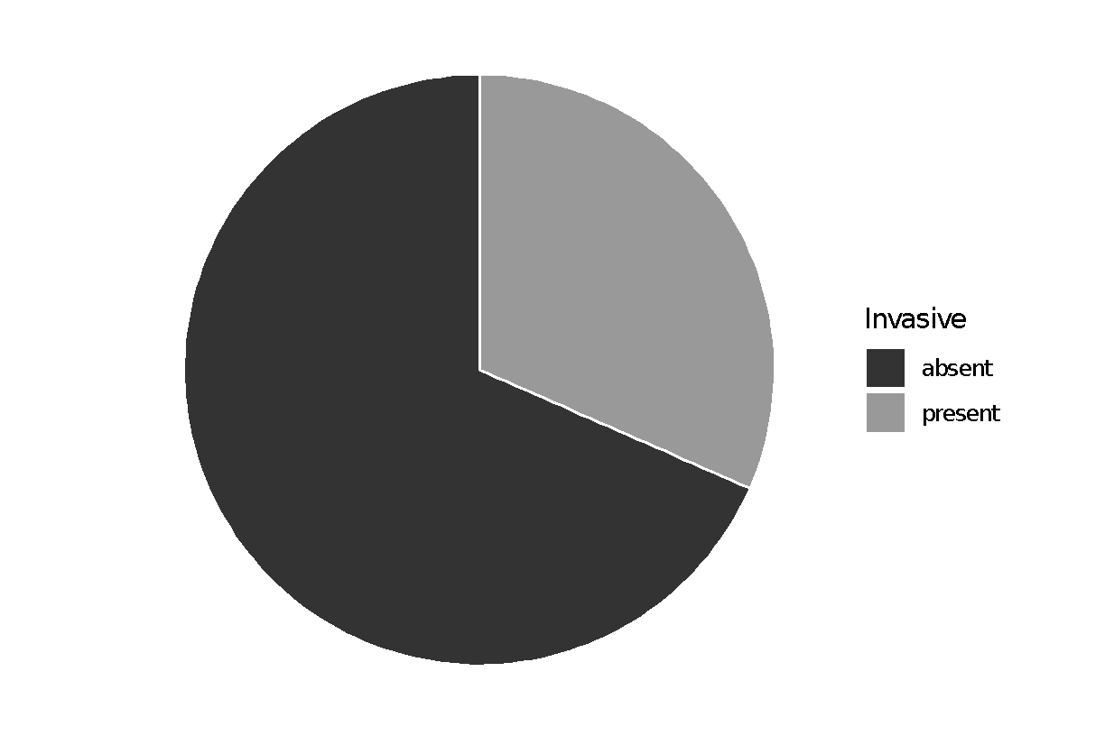
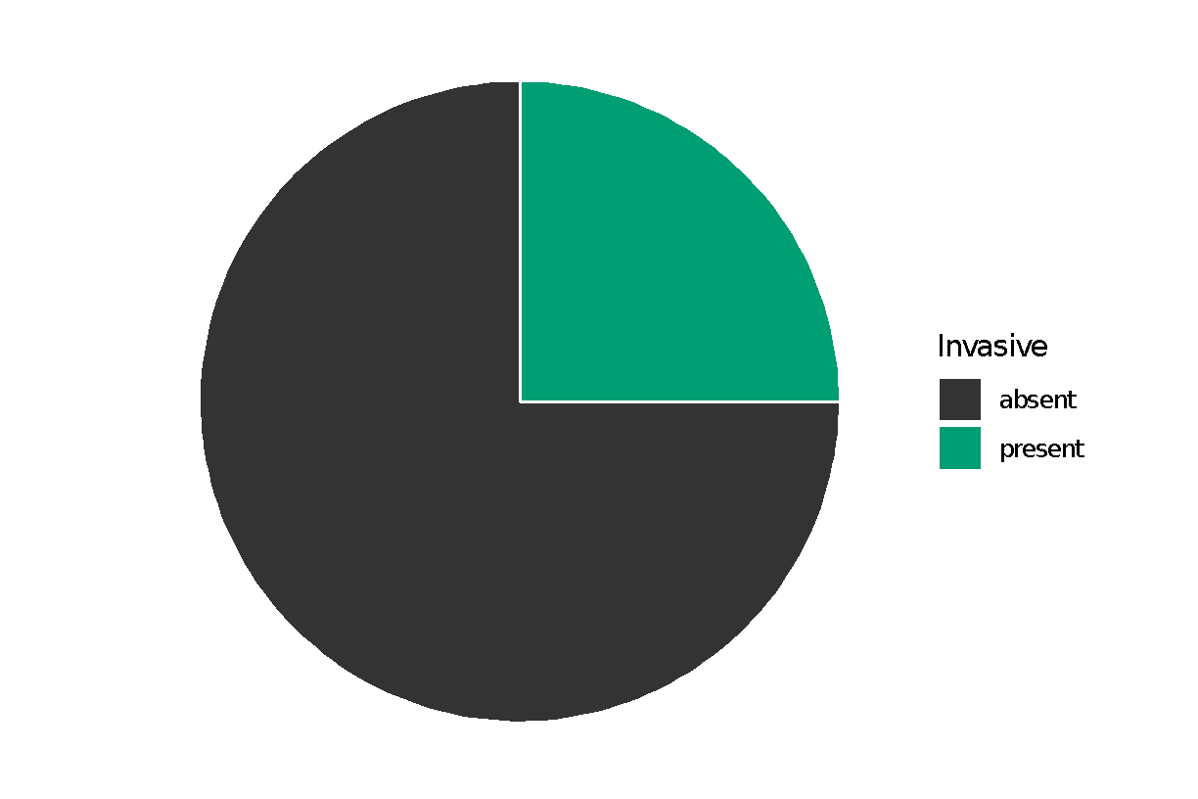
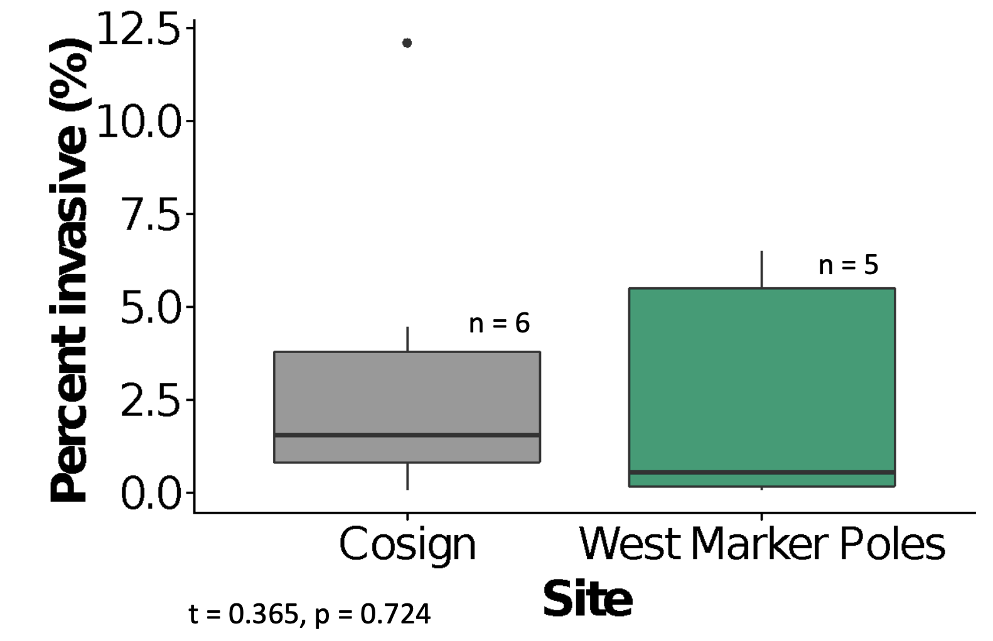
What percent of wrack patties have invasive algae?
Of the patties with invasive algae, what percent of the patty area is invasive?
** ADDITIONAL SURVEYS EXIST FROM SCI (2 TRIPS) AND ANOTHER SNI TRIP. THESE ARE NOT INPUTTED YET

